Slide 1
Getting Data in the Lab
LabVIEW, Data Acquisition,
and Instrument Control
Dr. Jason D. Sommerville
President, UPVI, LLC.
jason.sommerville@upvi.net
www.upvi.net
Copyright © 2015 UPVI, LLC. Redistribution is prohibited.

Slide 2
Getting Data in the Lab
Part 2: Data Acquisition
Copyright © 2015 UPVI, LLC. Redistribution is prohibited.

Slide 3
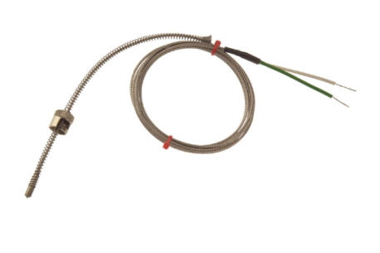
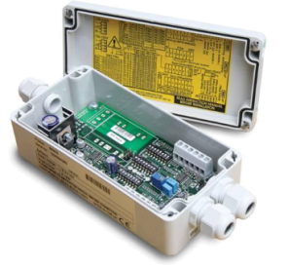
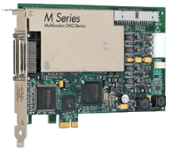
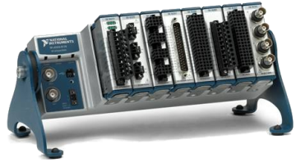

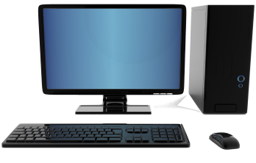
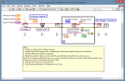
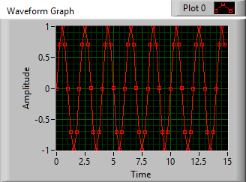

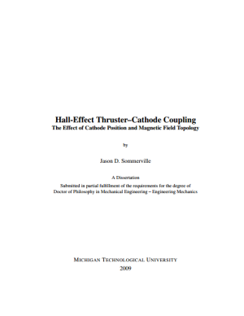

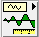


Transducer
Signal Conditioner
DAQ Hardware
Thermocouple
Amplifier, Low pass filter
NI CompactDAQ
Computer
Brought to you by IT
Phenomenon
Plotting
Software Basics
Cooling of Tea
Thesis/
Dissertation
Graduate!
Analysis
Curve fitting
DAQ
Storing Data
Analog Input
HDF5 Files

Slide 4
Data Acquisition
Data Acquisition or DAQ is the process of converting real-world measurements into digital computer data
Signal measurement
Signal digitization
Moving the data to computer memory and/or disk
DAQ may also encompass signal generation
Waveform generation
Triggering
Control systems
All the components must be compatible with each other!
But we have to break it down in the lecture and handle one thing at a time
In 2016, if you’re writing data down by hand, you’re probably doing it wrong

Slide 5
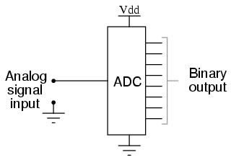
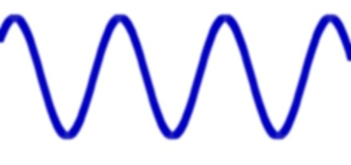
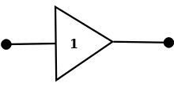
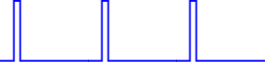
Types of DAQ: Signal Acquisition
Analog Input
Convert analog voltage signals into digital data
Single-shot or timed measurements
Use an analog-to-digital converter
Examples: temperature, sounds, voltage
101110110100 101110100101 011001100101
110011000101 011100101010 110110001000
Digital Input
Counter/Timers
Single-shot or timed
Single bit or bus
Example: proximity sensor, photointerrupter
Count events
Time events
Examples: encoders, pulse train timing, delay timing, delay generation
555
4, 5, 6, …
1 or 0
10 ms
Buffer
Counter/Timer
10 ms

Slide 6
Types of DAQ: Generation
Analog Output
Convert digital data into analog waveforms
Single-shot or timed generation
Use a digital-to-analog converter
Examples: sound, system excitation, motor control
101110110100 101110100101 011001100101
110011000101 011100101010 110110001000
Digital Output
Counter/Timers
Single-shot or timed
Single bit or bus
Generating a slow trigger, controlling an LED, controlling a bus
Control timing
Examples: Pulse train generation, delay generation
555
4, 5, 6, …
1 or 0
10 ms
Counter/Timer
10 ms
Buffer

Slide 7
Transducer
Signal Conditioner
DAQ Hardware
Transducer
Thermocouple
Amplifier, Low pass filter
NI CompactDAQ
Thermocouple
Computer
Brought to you by IT
Phenomenon
Plotting
Software Basics
Cooling of Tea
Thesis/
Dissertation
Graduate!
Analysis
Curve fitting
DAQ
Storing Data
Analog Input
HDF5 Files

Slide 8
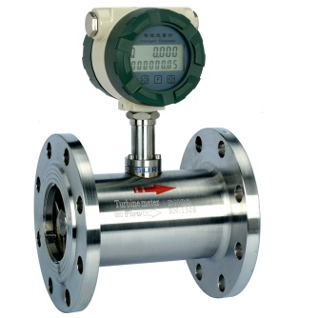
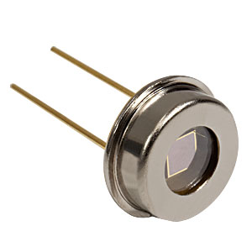
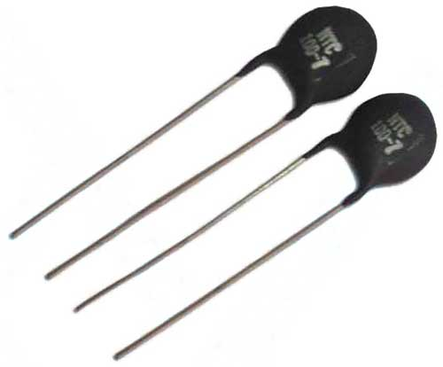
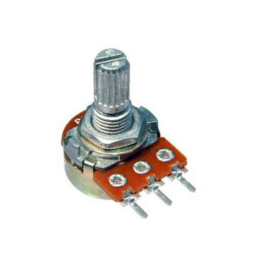
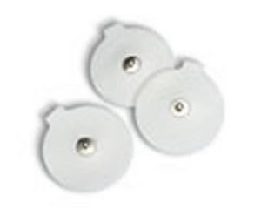
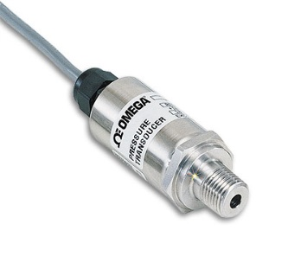
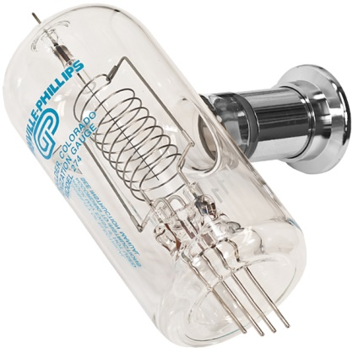
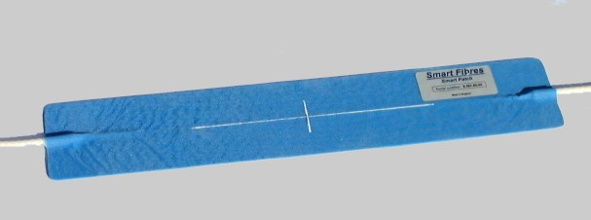
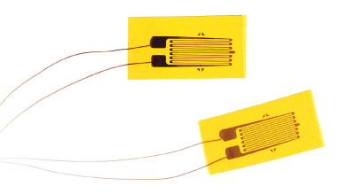
Transducers
Convert real world data into something that can be measured by a data acquisition device
Voltage
Current
Resistance
Also called sensors

Slide 9
Transducer Menagerie
Temperature | Pressure | Flow
Thermocouple Thermistor RTD IC Temp Sensor IR Sensor Fiber Bragg Grating (FBG) | Piezo-resistive strain gauge Capacitive Electromagnetic Piezoelectric Microphone FBG Ion gauge | Differential Pressure Pitot tube Calorimetric Turbine Electromagnetic Ultrasonic
Light | Position/Velocity | Strain, weight, etc
Photodiode Phototransistor Photomultiplier Single-photon avalanche diode CCD/CMOS array | Optical Encoders (A,L) LVDT (L) Resolver (A) Potentiometer (A) String Pot (L) Radar (L) Laser interferometry (L) | Strain gauge Load cell Piezoelectrics

Slide 10
How to chose a transducer
What type of measurement do you need to make?
Calibration Curve
Range
Input range (25 – 300 ºC, 1 – 100 mN, etc.)
Output range (0 to 10V, -5 to 5 V, 4 to 20 mA, etc.)
Sensitivity—How well can change be detected?
How good is the measurement?
Accuracy (±1 ºC, ±0.1 mN, etc.)
Precision (repeatability)
Linearity—can be handled in software
Drift—Change in calibration over time
Hysteresis—is it the same going up as coming back down?
Timing
Response time
Bandwidth (1 Hz, 100 kHz – 1 MHz, etc.)
Other considerations
Analog or digital
Analog: voltage, current, impedance, etc.
What signal conditioning or excitation/power does it require?
How will I connect it to my DAQ system?
Environmental isolation
Voltage, temperature, noise, vacuum, water, etc.
Ruggedness
Cost
Q: Where do I find this stuff?
A: All this info should be on the transducer’s datasheet or specification sheet
(which should be available from the manufacturer’s website)

Slide 11
Range
Range specifies the maximum and minimum values a transducer can accurately handle
Input range (or just “range”) is the values of the real world signals that can be accurately measured
0 – 100 degrees C
0 – 10 mN
-500 – 500 mm
Should cover the expected range of your physical system!
Output range is the corresponding range of output:
0 – 10 V
-2 – 5 V
4 – 20 mA
0 – 100 kΩ
Must work with your DAQ system!

Slide 12
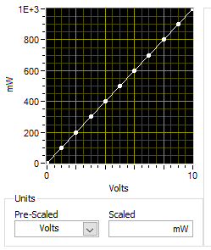
Sensitivity
How much does the output change for a given change in input?
That is, the slope of the calibration curve
Units of output unit/physical unit
V / deg C
V / N
mV / mrad
mA / (L/s)
Tradeoff between sensitivity and range
Sensor may not be equally sensitive across its full range
I.e., calibration curve may not be linear

Slide 13
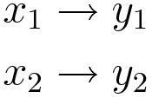
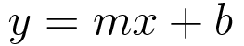
Calibration Curve
Relates the physical input signal to the electrical output signal
Linear
Mapped ranges
A linear function is used to relate input (x) to output (y).
Different way of specifying a linear calibration curve

Slide 14
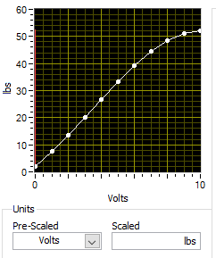
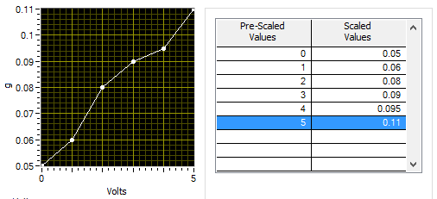
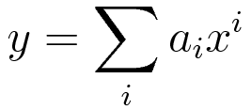
Calibration Curve
Relates the physical input signal to the electrical output signal
Functional, e.g polynomial
Table, i.e. piecewise linear
A general function is used to relate input (x) to output (y), e.g.
Linearly interpolate between measured points.
Useful for measured calibration curves

Slide 15
Example
Thermocouples measure the difference in temperature between the hot junction and the cold junction
There are different types of thermocouples for different temperature ranges
More reading: http://www.ni.com/white-paper/4218/en/

Slide 16
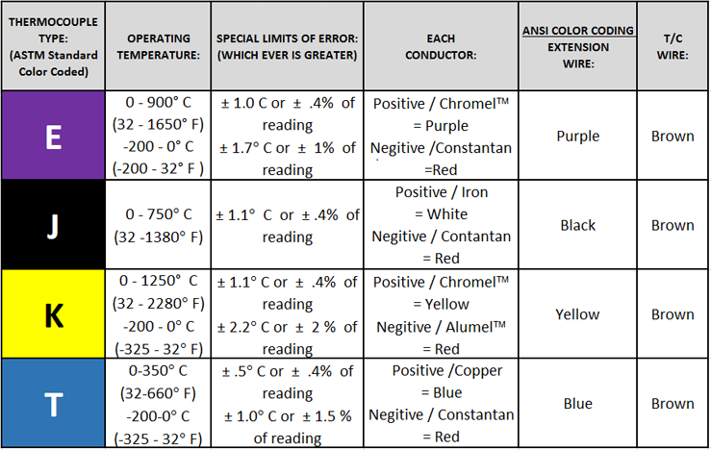
Range: Choosing a thermocouple
http://www.temprel.com/support/how-to-choose-thermocouple.aspx

Slide 17
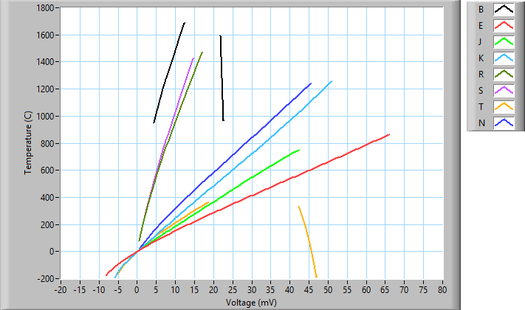
Linearity and Sensitivity: Ex: Choosing a thermocouple

Slide 18
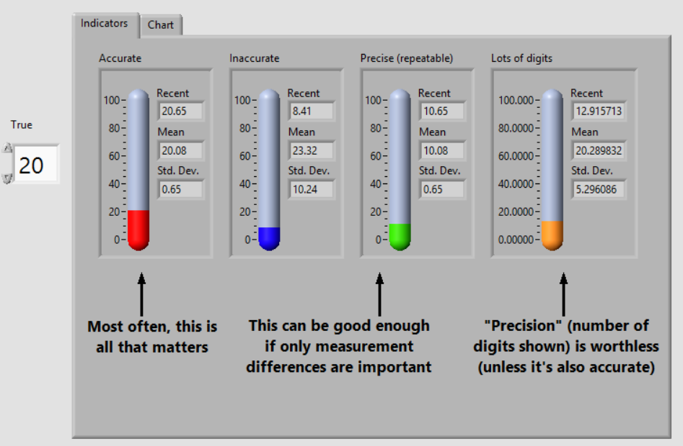
How well does it measure?

Slide 19
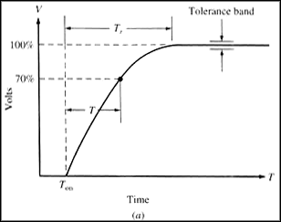
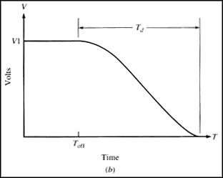
Response/Rise/Fall Time
How fast can the sensor respond to changes in the measured property?
Hall sensor
Rise Time
Fall Time

Slide 20
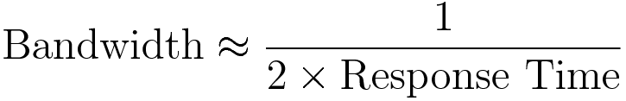
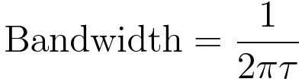
Bandwidth
Usually another way of specifying the response time
Note: For response time given as 10% to 90% rise/fall

Slide 21
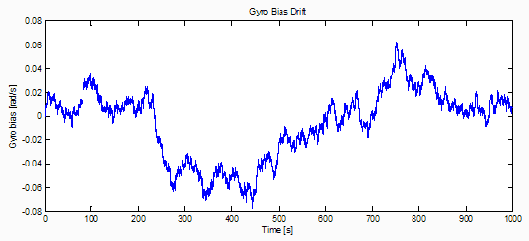
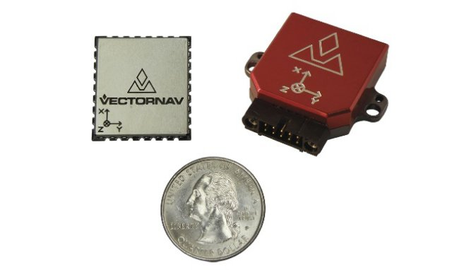
Drift
The calibration of a sensor may change over “long” periods of time
Temperature effects
Humidity effects
Aging effects
What is long? Depends on your measurement.
Source: http://www.vectornav.com/support/library/calibration

Slide 22
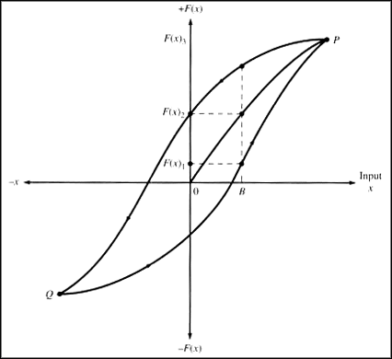
Hysteresis
Is it the same going up as coming down?
Image: http://www.ni.com/white-paper/14860/en/#toc8

Slide 23
Reading a Spec Sheet
Show examples of ways in which specifications are given.

Slide 24
Analog vs. Digital
Nearly all transducers are analog internally
However, some are packaged with dedicated ADCs, signal conditioners and may provide digital communication outputs
Analog
Digital
Voltage, current, impedance, etc.
Requires DAQ device
Typically faster
Sensor response time limits update speed
Typically cheaper
Transmission lines susceptible to noise
More difficult/expensive to isolate
Communicates via GPIB, RS-232, USB, Ethernet, etc.
May require interface card, or may be built into system
Typically slower and more expensive
Comm limits update speed
Typically more expensive
Less susceptible to noise
Easier to isolate

Slide 25
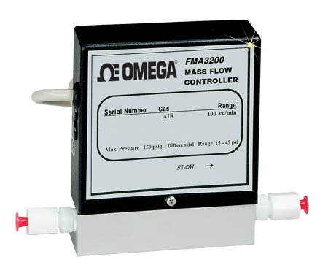
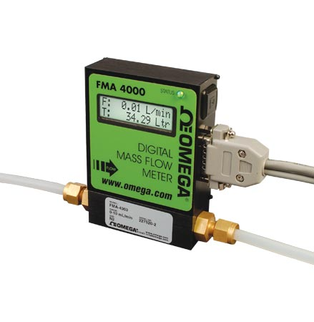
Example: Gas Flow Meter
Analog: Omega FMA-3103
Digital: Omega FMA-4102
No internal calibration curve
Analog output only
Output is linearized
=> internal signal conditioning
Update rate of 0.5 Hz
Cost: $375
Internal, programmable gas calibration curves
Interface: RS-232 or RS-485
Unspecified, probably about 2 Hz
Cost: $730
http://www.omega.com/pptst/FMA3100_3200_3300.html
http://www.omega.com/pptst/FMA4100_4300.html

Slide 26
Transducers: Other Considerations
What signal conditioning or excitation/power does it require?
How will I connect it to my DAQ system?
Cabling
Isolation (see next bullet)
Environmental isolation
Voltage, temperature, noise, vacuum, water, etc.
Ruggedness
Cost

Slide 27
How to chose a transducer
What type of measurement do you need to make?
Calibration Curve
Range
Input range (25 – 300 ºC, 1 – 100 mN, etc.)
Output range (0 to 10V, -5 to 5 V, 4 to 20 mA, etc.)
Sensitivity—How well can change be detected?
How good is the measurement?
Accuracy (±1 ºC, ±0.1 mN, etc.)
Precision (repeatability)
Linearity—can be handled in software
Drift—Change in calibration over time
Hysteresis—is it the same going up as coming back down?
Timing
Response time
Bandwidth (1 Hz, 100 kHz – 1 MHz, etc.)
Other considerations
Analog or digital
Analog: voltage, current, impedance, etc.
What signal conditioning or excitation/power does it require?
How will I connect it to my DAQ system?
Environmental isolation
Voltage, temperature, noise, vacuum, water, etc.
Ruggedness
Cost

Slide 28
Signal Conditioner
Transducer
Signal Conditioner
DAQ Hardware
Transducer
Amplifier, Low pass filter
Thermocouple
Amplifier, Low pass filter
NI CompactDAQ
Thermocouple
Computer
Brought to you by IT
Phenomenon
Plotting
Software Basics
Cooling of Tea
Thesis/
Dissertation
Graduate!
Analysis
Curve fitting
DAQ
Storing Data
Analog Input
HDF5 Files

Slide 29
Signal Conditioning
Modify the transducer output so that it can be accurately measured by the DAQ system
Some basic signal conditioning is often included with some transducers and some DAQ systems
X -> Voltage conversion
Amplification
Anti-aliasing filters
Amplification/Attenuation
Small signals (typ. <100 mV) should be amplified to a range readable by the ADC
Large signals (>5 – 10 V) voltage signals need to be attenuated
Filtering
Noise: use low-pass or notch filters to remove known noise sources
Anti-aliasing filter: a low-pass filter designed to prevent high-frequency components from being digitized and aliased by the DAQ system

Slide 30
Signal Conditioning (cont.)
Voltage Isolation
Allows signals at high potential differences to be safely connected to a DAQ system
Linearization
Corrects for non-linearities in the transducer
In modern systems this is usually done in software
Transconductance, etc.
Convert current signals to voltage signals
Other conversions possible as well (i.e. resistance to voltage, pulse-train to voltage, etc.)
Excitation
Some sensors, e.g. RTDs and strain gauges, require a power source to excite them
Not strictly signal conditioning

Slide 31
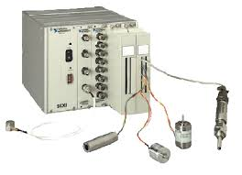
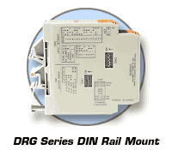
Signal Conditioning—Hardware
Amplifiers and filters often build into DAQ hardware
Rack and rail systems
NI SCXI
Omega DRG or OM7
Custom solutions
Build it yourself
NI SCXI
Omega DRG Module

Slide 32
Signal Conditioner
Signal Conditioner
DAQ Hardware
Transducer
DAQ Hardware
Amplifier, Low pass filter
Amplifier, Low pass filter
NI CompactDAQ
Thermocouple
NI CompactDAQ
Computer
Brought to you by IT
Phenomenon
Plotting
Software Basics
Cooling of Tea
Thesis/
Dissertation
Graduate!
Analysis
Curve fitting
DAQ
Storing Data
Analog Input
HDF5 Files

Slide 33
How to choose DAQ hardware
What type of signals do you need to acquire/generate?
How many channels of each type?
After external conditioning, what will the polarity and range of your signal be?
DI/SE?
What resolution do you need across that range?
What bandwidth do you need?
At what rate do you need to acquire/generate the data?
Note that bandwidth ≠ sampling frequency, but related
How precise are you timing requirements? Can you use software timing?
How much time-skew is acceptable?
Memory depth if signals cannot be transferred to system memory
Connectors
Form factor
Computer interface (e.g. PCIe, PXI, USB, etc.)
Software interface
Front panel controls
Cost

Slide 34
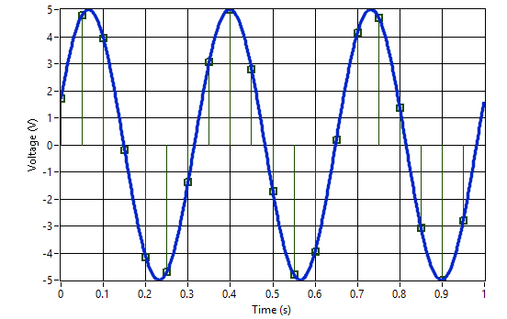
Analog Input Digitization
Digitized Samples
Sample Index | Time (s) | Voltage (V)
0 | 0.00 | 1.7101
1 | 0.05 | 4.80631
2 | 0.10 | 3.94005
3 | 0.15 | -0.174497
4 | 0.20 | -4.14519
5 | 0.25 | -4.69846
6 | 0.30 | -1.37819
7 | 0.35 | 3.07831
8 | 0.40 | 4.99695
9 | 0.45 | 2.79596
10 | 0.50 | -1.7101
11 | 0.55 | -4.80631
12 | 0.60 | -3.94005
13 | 0.65 | 0.174497
14 | 0.70 | 4.14519
15 | 0.75 | 4.69846
16 | 0.80 | 1.37819
17 | 0.85 | -3.07831
18 | 0.90 | -4.99695
19 | 0.95 | -2.79596
Analog signal: 3 Hz Sine
Sampling Period: 50 ms (20 Hz)

Slide 35
DAQ: Analog Input
Central component is the Analog-to-Digital (ADC) converter
Digitizes the analog signal and making a digital measurement available for storage in memory
ADC must be supported by amplifiers, clocks, multiplexers, and other items
Typical DAQ-AI system has the following parameters:
Differential vs. Single-ended inputs
Voltage range and polarity (bipolar or unipolar)
Gain settings
ADC resolution
Sampling speed and bandwidth
Multi-channel multiplexing

Slide 36
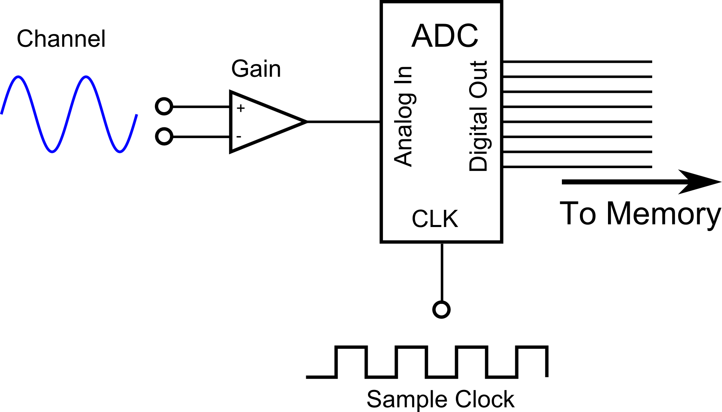
Analog Input
Differential Input (DI)

Slide 37
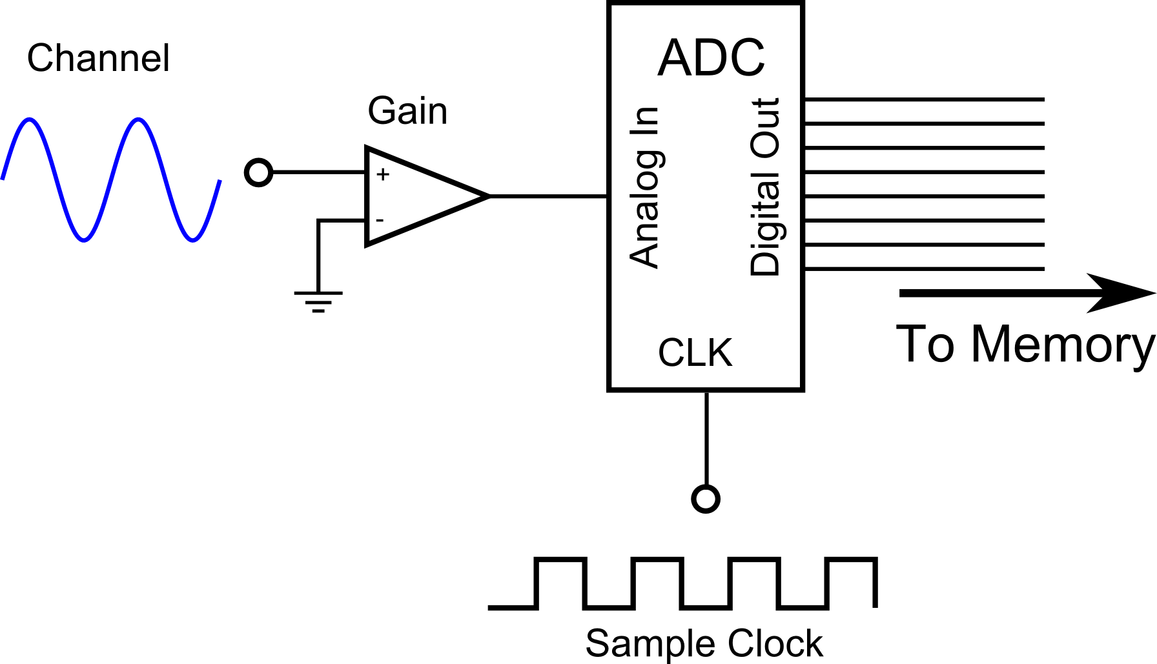
Analog Input
Single-ended Input (SE)

Slide 38
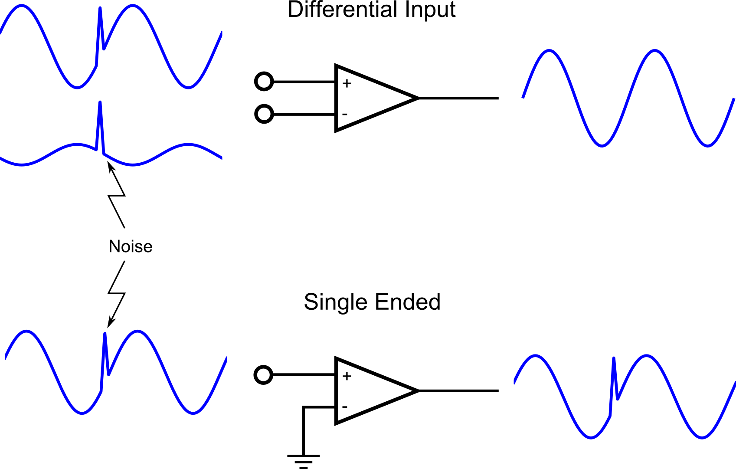
Analog Input: DI vs. SE

Slide 39
Analog Input: DI vs. SE
Differential Input
Single-Ended
Used with balanced signal lines
Less susceptible to noise
Less likelihood of ground loops
Lower channel count
Used with unbalanced signals
Increased susceptibility to noise
Increased likelihood of ground loops
Higher channel count
Differential Input Caveats
Voltage difference must be within DAQ range
Neither side must float too far from DAQ ground

Slide 40
Analog Input
Digitized Samples
Resolution: 16 bits across the range
Bi-polar, Range: ±5 V
Analog signal: 3 Hz Sine
Sampling Period: 50 ms (Rate is 20 Hz)

Slide 41
ADC Range and Polarity
Range: the maximum and minimum voltage that may be read
Unipolar: only read signals >= 0 V (or only <= 0, sometimes)
Bipolar: may read positive and negative signals
Most Common Ranges:
±5 V, ±10 V
Bi-polar, Range: ±5 V

Slide 42
Gain Settings
Configurable gain settings allow ADC to make more use of available ADC resolution
Note that noise is also amplified—better to amplify at source, if possible
Signal here must be (e.g.) ±5 V to make full use of ADC resolution
Gain is software-configurable

Slide 43
Gain Settings
Working range <= signal range
e.g.: ±250 mV
Gain, e.g. 20
ADC range, e.g. ±5 V

Slide 44
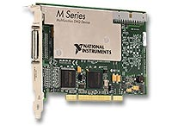
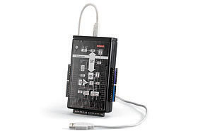
Gain Settings: Specifications
Spec. Ranges
Spec. Gains
Multiple ranges specified
Gain unspecified
Actual ADC range unspecified
Example: NI PCI-6251
http://www.ni.com/pdf/manuals/375213b.pdf
Multiple gains specified
Only maximum range specified
ADC range must be specified
Example: Keithley KUSB-3101
(Actually specifies both)
http://www.keithley.nl/data?asset=50072

Slide 45
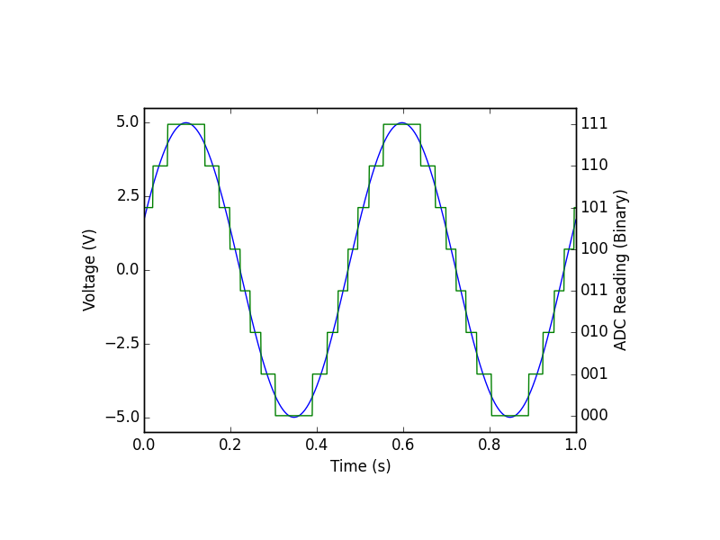
ADC Resolution: 3 bits
Number of bins = 2³ = 8
Range = 5V – (-5V) = 10 V

Slide 46
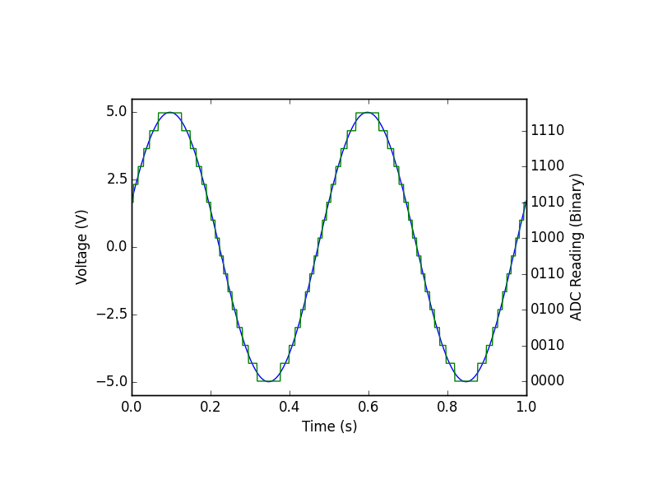
ADC Resolution: 4 bits
Number of bins = 2⁴ = 16
Range = 5V – (-5V) = 10 V

Slide 47

ADC Resolution: 8 bits
Number of bins = 2⁸ = 256
Range = 5V – (-5V) = 10 V

Slide 48
ADC Resolution
The resolution with which a signal can be measured, specified in bits
Resolution in volts is given by ADC Range, Gain setting, and ADC resolution
Note that sometimes the specified “range” will be the product of the smallest gain and range, or all range-gain products will be specified.
Most Common Resolutions:
8, 12, 16, 24
Example:

Slide 49
Voltage <-> ADC Reading
Example:, 5 – (-5) V range, 16 bit resolution, reading = 8745
Other direction:

Slide 50
Sampling Speed
The maximum rate that the hardware can make ADC conversions
In samples per second
E.g. 250 S/s, 350 kS/S, 10 MS/s
Hardware or software controlled?
Low-end hardware must be clocked by software—very unreliable timing on modern Oses, no better than 100 ms
Lab-quality software will use hardware timing
What about bandwidth?
A system may be able to sample above its bandwidth
Imagine putting a 10 Hz low-pass filter ahead of your 10 MS/s ADC
Bandwidth is set by the analog characteristics of the electronics
Bandwidth may be affected by your setup, esp. cabling.
Usually not a concern until you get to 10s – 100s of MHz

Slide 51


Undersampling
Digitized Samples
Undersampled data causes aliasing
The alias looks like a lower frequency signal
Analog signal: 35 Hz Sine
Sampling Period: 50 ms (20 Hz)
Alias Period: 200 ms (5 Hz)

Slide 52
Nyquist-Shannon Sampling Theory
“The sampling frequency must be greater than or equal to twice the bandwidth of the signal sampled to determine the frequency content of the sample.”
If bandwidth starts at 0 Hz (usual), BW is simply the maximum frequency component in our sample.
If you need to determine the non-sinusoidal shape of a signal repeating at X Hz

Slide 53

Anti-alias Filters
If you know you have frequency components which are not interesting, use an anti-alias filter.
Prevents aliasing by preventing the signal!

Slide 54
Trade off: Resolution or Speed
For the same priced-system, there is a tradeoff between resolution and sample speed.

Slide 55

Analog Input: Multiplexing
Sample Clock: Acquire one data point from every channel
Convert Clock: Acquire one data point from any channel
Convert Clock
Sample Clock/N
Sample Clock

Slide 56

Analog Input: Time Skew
Sample Clock
100 Hz
Scan Clock
10 Hz

Slide 57
Dealing with Time Skew
Live with it
Does it really matter for your data?
Make sure you understand the effect it will have on your data
By far the most common solution
Sample-and-hold circuitry
An analog circuit which captures all channels’ voltages simultaneously
Allows ADC and MUX to cycle through sampled voltages at scan clock rate
Multiple ADCs

Slide 58

Analog Input: Full Disclosure
Gain circuitry actually comes after the MUXs in most designs.
This explains the tradeoff between DI/SE and channel count

Slide 59




Some Examples
NI CompactDAQ Platform
USB connectivity or embedded controller
Modules support AI, AO, DIO Counter/timers, some signal conditioning
$800+
Meas. Computing PCI-2513
PCI card
16-bit AI 16 SE/8 DI
1 MS/s
DIO, counter/timers
$909
NI USB-6008
USB connectivity
12-bit AI 8 SE/4 DI
10 kS/s
2 AO
$189
NI PXIe Platform
Embedded controller or PCIe bridge
Modules support everything
$2000+

Slide 60
How to choose DAQ hardware
What type of signals do you need to acquire/generate?
How many channels of each type?
After external conditioning, what will the polarity and range of your signal be?
DI/SE?
What resolution do you need across that range?
At what rate do you need to acquire/generate the data?
Note that bandwidth ≠ sampling frequency, but related
How precise are you timing requirements? Can you use software timing?
How much time-skew is acceptable?
What bandwidth do you need?
Memory depth if signals cannot be transferred to system memory
Connectors
Form factor
Computer interface (e.g. PCIe, PXI, USB, etc.)
Software interface
Front panel controls
Cost

Slide 61
Recall: Analog Input
Differential Input (DI)

Slide 62

Analog Output

Slide 63
Analog Output Hardware
For the most part, specs are exactly like Analog Input, but “in reverse”
Range: Voltage output range
Polarity: Bipolar or unipolar output
Gain: Typically only the working range is specified.
Selectable gains/working ranges far less common for output
Resolution: Specifies minimum output step size
Differential/Single Ended: yes, but
Almost always single ended
Why? Because we’re now the output. We choose the reference.

Slide 64
Analog Output

Slide 65
Analog Output Hardware: Timing
For the most part, specs are exactly like Analog Input
Timing: Hardware or software timed
Devices more likely to be software timed than their AI counterparts
Sample rate: Samples-per-second
Channels not multiplexed
Other hardware limitations prevent simultaneous update on most devices
Look at spec sheet to determine maximum sample rate for N channels
http://www.ni.com/pdf/manuals/370822c.pdf
New: Slew rate: maximum rate of change for output
New: Settling time: time required after a step change to achieve stable output.*
*Actually, ADCs have a settling time, but it’s not usually a limiting factor.

Slide 66

Analog Output Hardware: Timing
http://www.planetanalog.com/author.asp?section_id=3062&doc_id=560483

Slide 67
Affect of Slew Rate and Settling Time
Talk about the effects on output frequency

Slide 68

Cool example I spent 90 minutes on

Slide 69
Digital I/O Hardware
Wide variety of implementations—the following statements are most often true
Read the specs and docs!
Digital lines act like analog inputs or outputs EXCEPT:
Lines typically bidirectional (may be configured to be either input or output)
Lines are, of course, digital. Only read or generate two states called:
High and Low
On and Off
One and Zero
Etc.
* Not counting the “high-Z” state, meaning “not driven high or low”

Slide 70

Digital I/O Hardware
Lines often grouped into “ports”
Ports are typically 4 or 8 bits
Sometimes only ports, not individual lines may be configured to be input or output
Binary numbers may be written to ports in software
Same timing specifications apply to DIO lines:
Hardware or software timing
More likely to be software-only
Sample speed for hardware timed acquisitions
Slew rate → Rise time
Settling time

Slide 71

Using MAX DIO Test Panel
Follow along with this underwhelming example

Slide 72

Understanding Logic Levels
Levels are specified depending on whether they are inputs or outputs
This guarantees that outputs are always in the correct range for the inputs
Voltage | Description | TTL | LVTTL
V_{cc} | Supply voltage | 5.0 | 3.3
V_{OH} | Logic-high output voltage minimum | 2.7 | 2.4
V_{IH} | Logic-high input voltage minimum | 2.0 | 2.0
V_{IL} | Logic-low input voltage maximum | 0.8 | 0.8
V_{OL} | Logic-low output voltage maximum | 0.4 | 0.4
Figure from https://learn.sparkfun.com/tutorials/logic-levels/ttl-logic-levels

Slide 73

Many more logic families
More logic levels
Figure from http://www.interfacebus.com/voltage_LV_threshold.html
Most Devices

Slide 74


How to solve logic level problems
Ignore it
Some voltage levels are cross-compatible, e.g. most TTL and LVTTL
However—if at all possible, check all output levels before connecting to the input
Use level-shifter circuit (voltage level translation)
e.g. SN74LV4T125
Figures from Texas Instruments SN74LV4T125 Datasheet

Slide 75

Analog to Digital
Use a comparator to help an analog signal conform to your digital standard
In
Out

Slide 76
Reconfiguration Terminals
PFI (Programmable Function Inputs) Lines
Many digital terminals mapped to multiple functions via software
Allows more device functionality without increased connection count, cost and complexity
In NI terminology, these are “PFI” lines
Some lines will automatically map to default values depending on the software configuration
Some lines will need to be explicitly assigned in software
Make sure that you can map every function you intend to use to its own terminal simultaneously.
myDAQ User Manual, DIO section

Slide 77

Reconfiguration Terminals
Use NI-MAX to find function → terminal mappings

Slide 78

Counter/Timers—Special DIO
Counter/Timers are a special class of digital I/O specifically designed for—you guessed it—counting and timing.
They can operate in several modes, as configured by software
Measure or Generate
Single Pulses or Pulse Trains

Slide 79



Counter/Timers—Special DIO
Counter/Timers may be used to read Quadrature Encoders
(Linear or Rotary)
Generates two pulse trains
http://www.orientalmotor.com/technology/articles/servo-motor-glossary.html

Slide 80

Counter/Timers—Special DIO
Quadrature Encoders
Count rising edges on A
If B is low,
count up
If B is high,
count down
http://www.robotoid.com/appnotes/images/quad-encoding-waveform.png

Slide 81
Signal Conditioner
Signal Conditioner
DAQ Hardware
Transducer
DAQ Hardware
Transducer
Amplifier, Low pass filter
Amplifier, Low pass filter
NI CompactDAQ
Thermocouple
NI CompactDAQ
Thermocouple
Computer
Computer
Brought to you by IT
Brought to you by IT
Phenomenon
Phenomenon
Software Basics
Plotting
Software Basics
Cooling of Tea
Plotting
Cooling of Tea
Thesis/
Dissertation
Thesis/
Dissertation
Analysis
Graduate!
Analysis
Graduate!
Curve fitting
Curve fitting
DAQ
DAQ
Analog Input
Storing Data
Analog Input
Storing Data
HDF5 Files
HDF5 Files

Slide 82
Analog Input Software
Making your hardware work for you
Hardware Driver
Provides the a software interface to the hardware
For NI it’s NI-DAQmx
NI-DAQmx terminology:
Channel: a single interface, e.g. one AI channel, one counter-timer, etc.
Task: A acquisition or generation of:
one or more data points
on one or more channels
of the same type
and on the same device (usually).
Scale: a calibration curve for Analog Input or Analog Outputs

Slide 83

A Word about MAX
NI Measurement and Automation Explorer (MAX)
Central location for investigating NI Hardware and Software
Allows for global (i.e. system-wide) channel and task creation
Useful for fixed or infrequently-changed installations

Slide 84
The Mantra
Create, Configure, Start, Read/Write, Stop, Clear
Create: Open a device for further access
In other drivers: “open” or “initialize”
Configure: setup the task, including channel(s), range(s), timing, triggering, etc. for the task
Start: Begin the acquisition (or generation) process
Read/Write: read acquired data (or write data to be generated), typically repeatedly, until the task is complete
Stop: stop the acquisition but do not close the device and free the resources associated with it
Clear: okay, now close the device and free the resources
In other drivers: “close” or “finalize”

Slide 85
The Mantra
A note about NI-DAQmx
NI-DAQmx is “smart” and will attempt to do steps in the mantra that you “forget.”
If you don’t configure the task, defaults are chosen
If you don’t start the task before reading, it starts it when you attempt to perform the read
If you don’t stop the task before closing it, it stops it for you
For learners, especially, don’t “forget” to do any of the steps.
Leads to muddled thinking
May have unexpected results because the coder doesn’t understand what NI-DAQmx is doing under the hood.
Create, Configure, Start, Read/Write, Stop, Clear

Slide 86

Software Timed Analog Input
Uses system clock
Best timing ~ 1 ms period on modern, non-RT OSes
Subject to jitter due to processor multitasking
Must be used for process control systems
Maybe you should consider an RT system?
NI Example: Voltage - SW timed Input.vi

Slide 87

Software Timing: Jitter
Do Voltage – SW-Timed – Jitter.vi example

Slide 88
Finite Samples, Hardware Timed
To relieve jitter and free up the process, let the DAQ card handle the timing
We must now configure the channel timing
Use DAQmx Timing.vi
Specify:
Timing type (Finite samples in this case)
Frequency
Number of samples
Timing source*
*Timing source allows one to use an external clock rather than an internal clock. This is useful for clocking in data based on external events signals, e.g. an encoder pulse, a clock from another DAQ task (e.g. analog output) or an external instrument.

Slide 89

Finite Samples, Hardware Timed
See also NI Example: Voltage – Finite Input.vi

Slide 90

What’s really happening?*
1 Configuration Step
*This is still a simplification of the real architecture. Sorry.

Slide 91

What’s really happening?*
1 Configuration Step
N Reads w/o CPU

Slide 92

What’s really happening?*
1 Configuration Step
N Reads w/o CPU
N Reads w/ CPU at our leisure

Slide 93

Why is Hardware Timing better than Software?
1 Configuration Step
N Reads w/ CPU
N Writes w/ CPU
N Reads w/ CPU
All must be on time!

Slide 94

Continuous Sampling
Acquiring data forever
But how will I graduate?
Specify number of samples to read.
Defaults to “all available.”
See also NI Example: Voltage – Continuous Input.vi
Notes:
Modify Finite into Continuous

Slide 95

What’s really happening?
Circular Buffering
Notes:
Modify Finite into Continuous

Slide 96

What’s really happening?
Circular Buffering
Notes:
Modify Finite into Continuous

Slide 97

What’s really happening?
Circular Buffering
Notes:
Modify Finite into Continuous

Slide 98

What’s really happening?
Circular Buffering
Notes:
Modify Finite into Continuous

Slide 99

What’s really happening?
Circular Buffering
Notes:
Modify Finite into Continuous

Slide 100

What’s really happening?
Circular buffer overflows
Notes:
Modify Finite into Continuous

Slide 101

Buffer Overflows

Slide 102
Acquiring for Multiple Channels
Use one task to acquire data from multiple channel
Always works for multiple AI or DI channels on the same device
Sometimes works for multiple channels on different devices
Consider carefully the time skew implications. Are the devices synchronized?
E.g. cDAQ devices share a common clock
PXI Devices can share a common clock
USB devices will not have a common clock unless externally synchronized.

Slide 103


Acquiring for Multiple Channels
Specify multiple channels in the “physical channels” control
Use commas to separate, and colons to specify ranges
Using a loop to add multiple channels to a task
Allows for different ranges per-channel

Slide 104


Analog Output Software
Just like analog input, but write instead of read
Voltage – Software Timed Output.vi

Slide 105

Analog Output Software
Continuous Hardware Timed, e.g. function generator
Voltage – Continuous Hardware Timed Output.vi
See also: NI Example “Voltage – Continuous Output.vi”

Slide 106

Analog Output Software
Continuous Hardware Timed, with write updates
FirstHallSensorSimulator.vi
See also: NI Example “Voltage – Continuous Output.vi”

Slide 107

AO: Regeneration Mode
In continuous output operations, an important option is the “regeneration mode”
Regeneration Allowed: AO will continuously loop through data already in the buffer if no updates are available.
Default mode
Good for function generators and other continuous output
Regeneration Not Allowed: AO will require output buffer data to be updated as often as it is emptied.
Failure to do so results in a buffer underflow error
Access with DAQmx Write Property Node

Slide 108

Analog Output Software
Only update when you need to
Simulated Hall Effect Sensor.vi

Slide 109

Digital Input/Output
If you can do analog input, you can do digital input
If you can do analog output, you can do digital output
Look a the examples in the Example Finder
Hardware Input/Output->DAQmx->Digital Input/Output
Many devices only support software-timed DIO (including myDAQ)
In a bind, AI/AO can substitute for DI/DO
Software-timed Digital Output

Slide 110

Counter/Timer Input
Measure TTL pulse
Period
Frequency
Pulse Width
Count edges
Etc.
See NI Examples
See Polymorphic “DAQmx Create Channel.vi”
CounterTimer SW-Timed.vi

Slide 111
Counter/Timer Output
Generate
Single Pulse
Pulse Train
NI Examples
Hardware I/O -> DAQmx -> Counter/Timer->*
Counter Output – Continuous –no trigger.vi
NI Examples

Slide 112
Triggering
Use triggering to control when data acquisition occurs
Controls when the sample clock is active
Why would I want to do that?
Only get the data you need based on external conditions
Synchronize

Slide 113
Triggering – Common Types
Digital start trigger: start when a rising or falling edge of a TTL (0-5 V) signal is detected
Digital reference trigger: similar to digital start, but may acquire pre-trigger samples
Digital pause trigger: clock in data only while a digital signal is high/low
Analog* start trigger: start when a signal’s voltage rises above or falls below a certain level
Analog* reference trigger: similar to analog start, but with pre-trigger samples
Analog* pause trigger: clock in data only while an analog signal is above/below a threshold
*Most NI DAQ devices do not support analog triggering. A few do not support digital triggering. See http://digital.ni.com/public.nsf/allkb/E761255A5729CD2E862570310075A23A

Slide 114






Triggering
 | Digital | Analog
Start Trigger
Reference Trigger (Include pretrigger samples)
Pause Trigger (Gate)

Slide 115




Triggering

Slide 116
Digital Start Triggering
Show Digital – Finite Input Example

Slide 117
External Clocks
90% of the time we use the DAQ scan clock to clock input or output conversions
Sometimes we may want to synchronize each sample to another event. Examples:
Synchronize data acquisition/generation to an external instrument
Synchronize multiple tasks on a single device (e.g. AI and AO tasks)
Synchronize data acquisition/generation to another DAQ device
Acquire data by position rather than time by clocking with an encoder pulse
Create crazy acquisition patterns by using counter-timers, gates, external circuitry, etc.

Slide 118

Synchronizing to external clock
No different than normal hardware-timed I/O except for “Sample Clock Source” input to DAQmx Timing
Voltage – Continuous Input-ExtClk.vi

Slide 119

Sharing clocks with multiple tasks
It is possible to internally route the clock line from one task to another
On the same device
On different devices within a CompactPCI or PXI chassis
On different PCI/PCIe devices using the RTSI cable*
Sometimes you may need to manually route through PXI Trigger/RTSI lines using DAQmx Connect Terminals.vi
*http://digital.ni.com/public.nsf/allkb/A120195AAAA9222A86256C69007C8B27

Slide 120

Sharing clocks with multiple tasks
Master Task: the one that generates the clock
Slave Task: a task that uses the same clock as the master
Always start the slave task(s) first!!
Synch AI-AO.llb

Slide 121

Aside: LLBs
LLBs provide a functionality to put multiple VIs into a single file
They are old and disfavored
Pros:
Bundle multiple VIs into a single file for easy distribution
Cons:
LabVIEW specific (why not use a zip file?)
No hierarchy within LLB: no way to us subVIs folder, etc.
Really bad for source code control
New thing: Labview Projects and Libraries
Similar concept, but don’t bundle VIs into a single file.

Slide 122

The Power of Triggers and Clocks
Timing a I recently created using triggers and clocks

Slide 123
Problems with Digital Triggers and Clocks
Wrong polarity
Triggers look for rising or falling edges (or sometimes either)
Wrong voltage
Digital logic operates on specific voltage levels
Glitches

Slide 124
Problems with Digital Triggers and Clocks
More logic levels
Figure from http://www.interfacebus.com/voltage_LV_threshold.html

Slide 125
Problems with Digital Triggers and Clocks
How to solve level problems
Ignore it
Some voltage levels are cross-compatible, e.g. most TTL and LVTTL
However—if at all possible, check all output levels before connecting to the input
Use level-shifter circuit (voltage level translation)
e.g. SN74LV4T125
Figures from Texas Instruments SN74LV4T125 Datasheet

Slide 126

Problems with Digital Triggers and Clocks
Glitches
Glitches occur when noise causes a signal to rise above and then fall below the threshold very quickly
Glitch

Slide 127






Review
Create
Configure
Start
Read/Write
Stop
Clear

Slide 128
About Floating Sources
Unreferenced sources may float at potentials different from the DAQ potential
Unpowered devices
Devices power by batteries
Devices powered by isolated power supplies—Just because it’s plugged in doesn’t mean it’s grounded

Slide 129

Bias resistors
Differential signals may float outside of the operating range of the ADC
Floating source: powered by batteries or isolated supply
Bias resistors can hold the voltages in range by preventing the source from floating
Make sure source is actually floating!
Value R should be such that:
Output impedance < R < Input impedance
Typically 10 kΩ – 100 kΩ
Further reading: http://www.ni.com/white-paper/3344/en/#toc3

Slide 130
Signal Conditioner
Signal Conditioner
DAQ Hardware
Transducer
DAQ Hardware
Transducer
Amplifier, Low pass filter
Amplifier, Low pass filter
NI CompactDAQ
Thermocouple
NI CompactDAQ
Thermocouple
Computer
Computer
Brought to you by IT
Brought to you by IT
Phenomenon
Phenomenon
Software Basics
Plotting
Software Basics
Cooling of Tea
Plotting
Cooling of Tea
Thesis/
Dissertation
Thesis/
Dissertation
Analysis
Graduate!
Analysis
Graduate!
Curve fitting
Curve fitting
DAQ
DAQ
Analog Input
Storing Data
Analog Input
Storing Data
HDF5 Files
HDF5 Files

